Slide 1

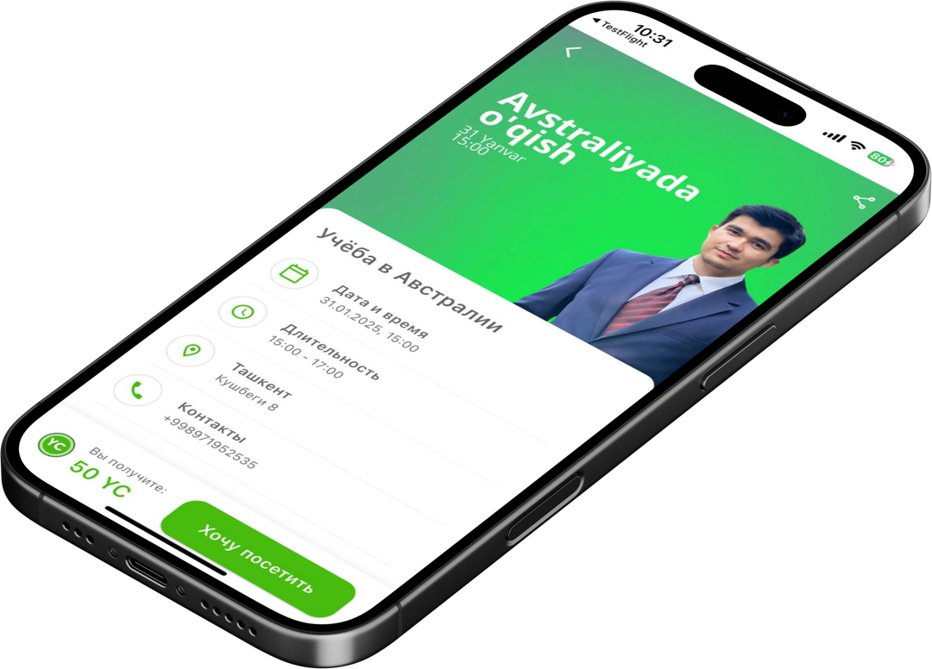
PRESENTATION OF THE ZIYO APP PROJECT

Slide 2
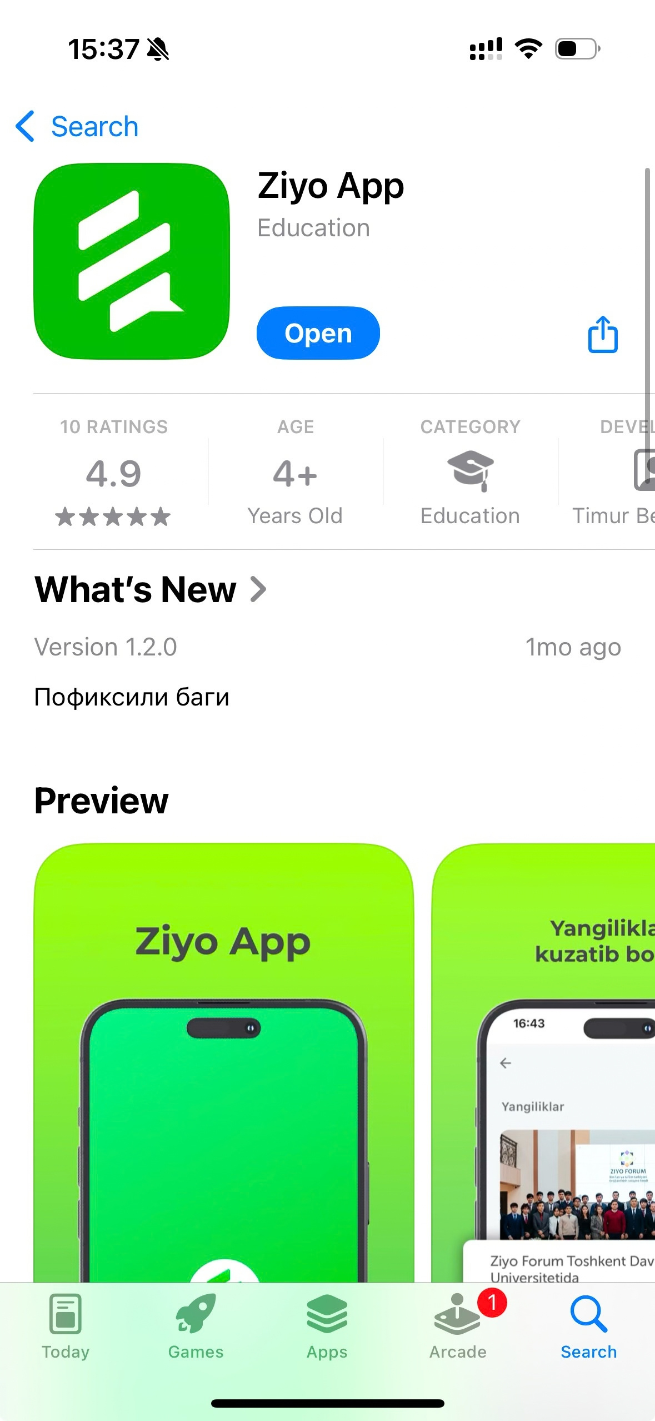
What is the Ziyo App?
ZIYO APP is a digital platform developed by Ziyo Forum for young people aged 15–30 in Uzbekistan.
The platform brings together:
  Free educational and cultural events
  Grants, internships and other opportunities
  Youth-related news and useful content
  Event registration and QR attendance
  Ziyo Coin reward system
Launched: June 1, 2025
Platforms: iOS & Android
Current focus: Uzbekistan
Our vision: to make ZIYO APP the first place young people in Uzbekistan go to find opportunities to learn, develop and participate.

Slide 3
WHAT MAKES ZIYO APP DIFFERENT
From discovering opportunities to taking action
ZIYO APP is not only an information platform. It connects the full user journey:
DISCOVER → REGISTER → PARTICIPATE → EARN → REPEAT
What users can do:
  Discover free opportunities
  Register directly through the app
  Confirm attendance through QR
  Earn Ziyo Coin
  Exchange Coin for rewards
Our core value proposition
One focused platform for free opportunities for young people — with participation and motivation built into the same experience.
The platform currently focuses on education, personal development, culture and youth careers, rather than paid commercial events.

Slide 4
WHAT WE HAVE ACHIEVED
From an idea to a functioning digital product
Since launching in June 2025, we have built the core product and operating model.
Key achievements:
📱 Launched on iOS and Android
👤 Built phone/SMS registration
📅 Developed the core event discovery and registration system
📲 Introduced QR self check-in
🪙 Created the Ziyo Coin reward system
🎁 Launched the reward store
🔔 Introduced pre-event push notifications
🎓 Added grants and other opportunities
📰 Developed news and Stories sections
🤝 Established initial partnerships with Conect, Human House, Khokimiyat and Women in Tech
~1,500 registrations were reached before the major server migration incident in summer 2026. Important: the 1,500 figure is a historical registration figure. After the migration incident, the current active base is approximately 50 users.

Slide 5
WHERE WE ARE TODAY
Area | Current status
Mobile application | Live
Active users | ~50 after migration
Historical registrations | ~1,500
Social media | 2–3 posts/week
Grants & opportunities | 2–3 publications/week
Recent partner activation | 2 Human House events in September
Analytics | Not yet standardized
Our main challenge - The platform needs a consistent flow of opportunities + a growing active audience.
This creates a growth loop:
More opportunities → more users → more value for partners → more partners → more opportunities
Breaking this cycle is currently one of our biggest strategic priorities.

Slide 6
WHAT WE NEED TO SOLVE
Our key strategic challenges
1. User Growth - Rebuild and grow the active user base after the server incident.
2. Partner Network - Move from individual manual outreach towards a scalable partner acquisition model.
3. Content Supply - Ensure a stable and diverse flow of events, grants, internships and other opportunities.
4. Product & User Experience - Make ZIYO APP more engaging and encourage users to return regularly.
5. Data & Analytics - Introduce clear KPIs and regular reporting to understand what drives growth.
6. Operational Scalability - Standardize cooperation between content, IT, SMM, partners and event venues.

Slide 7
WHAT WE EXPECT FROM SAP
We see the SAP collaboration as an opportunity to move from building the product → building a scalable growth model.
We expect SAP expertise to help us:
1) Define our Growth Strategy - Identify the most effective ways to attract, activate and retain young users.
2) Improve the Product & UX - Identify the most important product and user-experience improvements.
3) Build a Partner Strategy - Develop a scalable approach to acquiring and managing universities, companies, NGOs, cultural institutions and other partners.
4) Establish Analytics & KPIs - Define the metrics and dashboards needed to manage growth based on data.
5) Create an Operating Model - Make our internal processes more structured and scalable.
6) Build a 3-Year Roadmap - Translate all findings into clear priorities, responsibilities and milestones.

Slide 8
WHERE WE WANT TO GO
We want ZIYO APP to become:
The leading platform in Uzbekistan connecting young people with free educational, cultural and career opportunities.
2026 - Stabilize & Reactivate
  Recover the active user base
  Expand the partner network
  Establish analytics
  Improve operational processes
  Increase the flow of opportunities
2027 - Grow & Engage
  Expand to new cities
  Build local partner networks
  Launch competitions and exclusive events
  Develop gamification
  Expand the Ziyo Coin ecosystem
  Grow the ambassador network
Long-term - Scale the ecosystem
  Strong national partner network
  Active returning user base
  Sustainable operating model
  More opportunities for young people across Uzbekistan

Slide 9
THANK YOU VERY MUCH!

